Slide 1

Early Relapse Risk Detection Using Wearable Physiological Signals in AUD
Adarsh Konderu
C5051863 MSc Artificial Intelligence

Slide 2
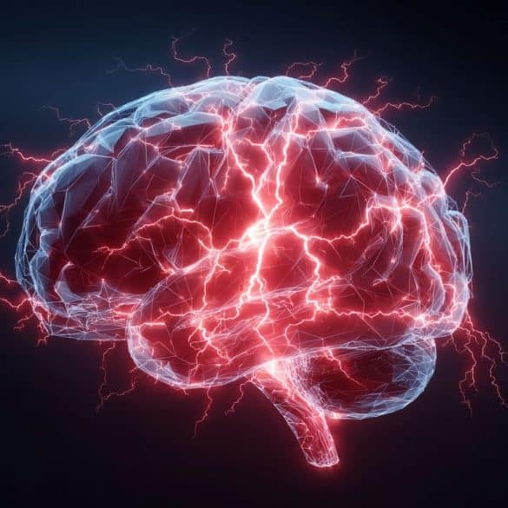
Problem & Objective Problem: • Stress is a major trigger for alcohol relapse • Current methods rely on self-reporting Objective: • Detect stress using wearable signals • Use ML to classify stress vs baseline

Slide 3
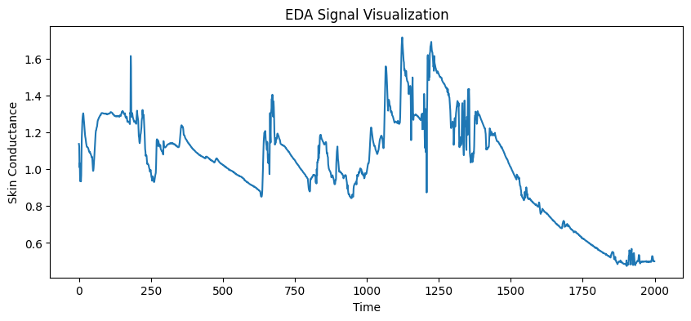
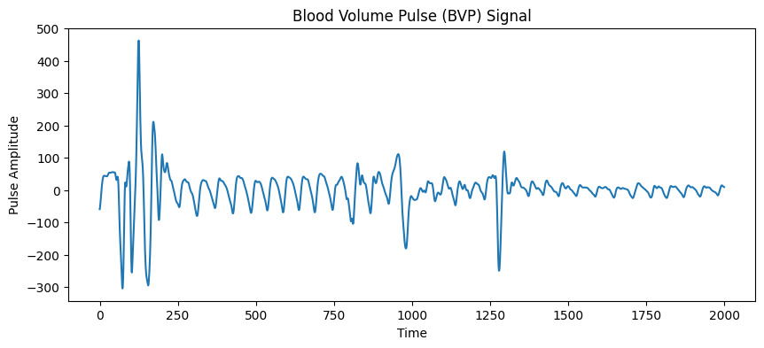
Dataset & Signals
Dataset:
WESAD
Signals:
• EDA (Electrodermal Activity)
• BVP (Blood Volume Pulse)
• Temperature
Participants: 15

Slide 4
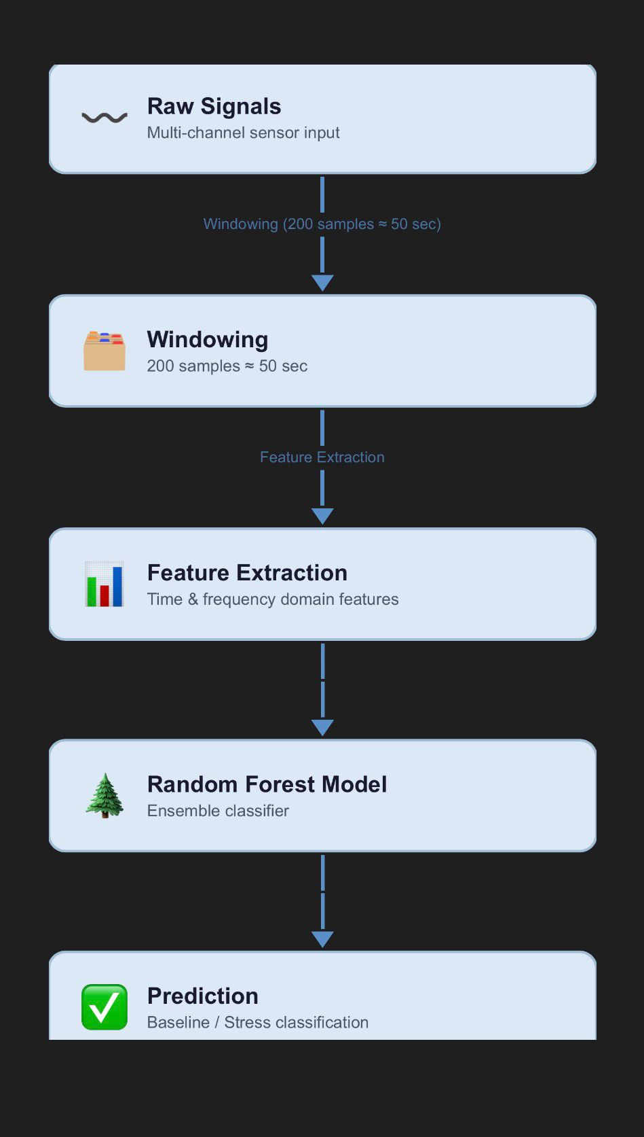
Methodology
Pipeline: Raw Signals → Windowing (200 samples ≈ 50 sec) → Feature Extraction (mean, std) → Random Forest → Prediction

Slide 5
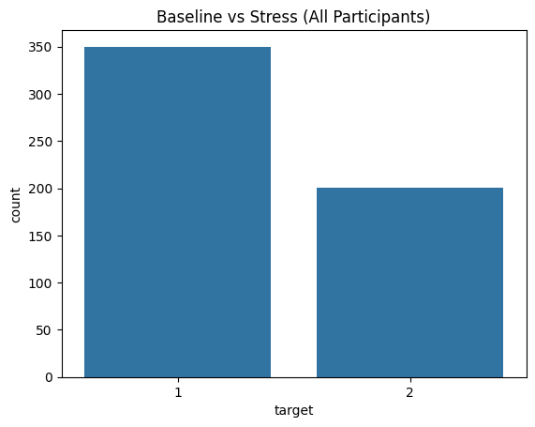
Data Distribution & Model
Baseline vs Stress samples
Balanced dataset
Model:
Random Forest
Handles nonlinear patterns
Reliable performance

Slide 6
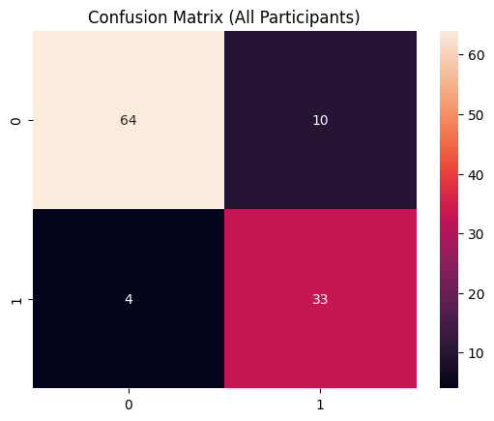
Results
Accuracy ≈ 87%
Confusion Matrix:
• Correct: 97
• Incorrect: 14
Strong stress detection

Slide 7
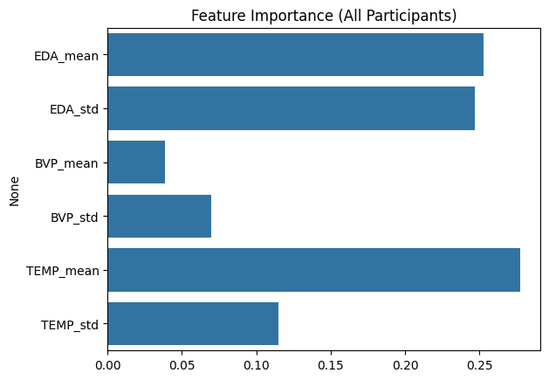
Findings & AUD Relation
Findings: • Signals reflect stress patterns • Model distinguishes stress vs baseline AUD Link: Stress → Relapse trigger → Early stress detection helps identify risk

Slide 8

Reflection & Conclusion
Reflection:
• Accuracy decreased with more data
Results became more realistic
• Real-world data is complex
Conclusion:
• Stress detection using wearables is possible
• Model shows strong performance

Slide 9
Limitations & Future Work
Limitations:
• No direct relapse data (only stress used as indicator)
• Limited features (mean, standard deviation)
• Physiological signals may overlap between classes
Future Work:
• Use advanced features and signal processing
• Apply deep learning models (CNN, LSTM)
• Use larger and real-world datasets
• Develop real-time wearable monitoring system

